Slide 1
Impact of close venues in house pricing

Slide 2
Business Problem
Knowing the impact of venues close to a house in its price can helping choosing to invest in houses.
Overall gain could increase.

Slide 3
Data Set
IBM`s King County, USA data for Houses Sold in 2014-2015 and their main features.
Foursquare API Data of the venues in a 500m radius of the houses sold, used as na approximation since these venues are 2020 data.

Slide 4
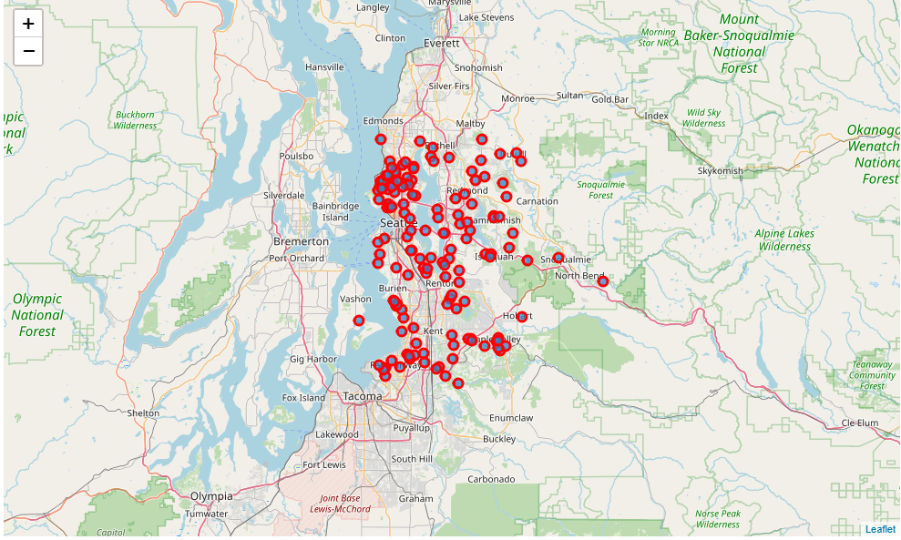
Exploratory Data Analysis First Data Set(Sample = 150)

Slide 5
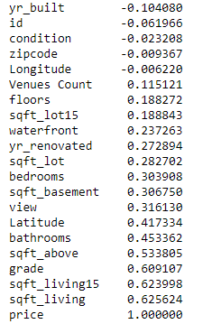
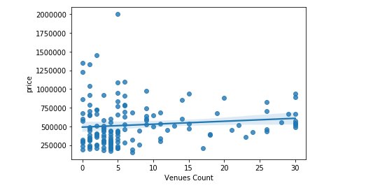
Relation between those variables

Slide 6
Conclusion
The overall impact for the amount of venues over the price appears to be small.
This could be because of the houses fair from many venues being bigger.

